Slide 1
Object Oriented Programming
Lecture 04

Slide 2
Comments
Comment-The contents of a comment are ignored by the compiler.
Three type of comment in java.
1. Single line comments(Slash-Slash)
//text
// This comment extends to the end of the line.

Slide 3
2. Multiple line comments
/* This comment, a "slash-star" comment, includes multiple lines.*/
3. Documentation Comments
/** documentation */
The last type of comment is the Javadoccomment. This comment type has some guidelines that allows a Javadocreader to display information about a Java method or class by using special tags

Slide 4
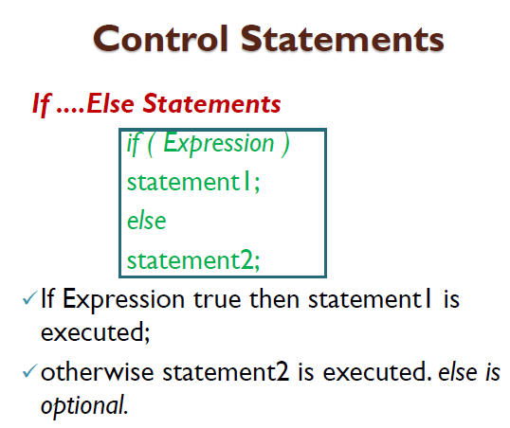

Slide 5
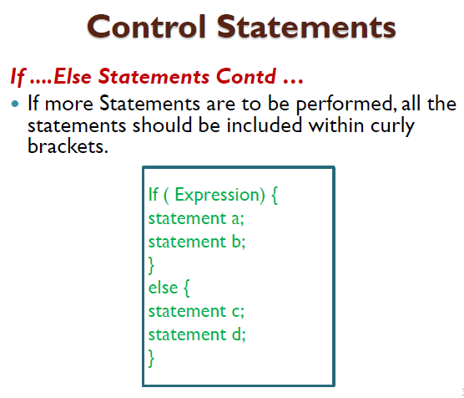

Slide 6
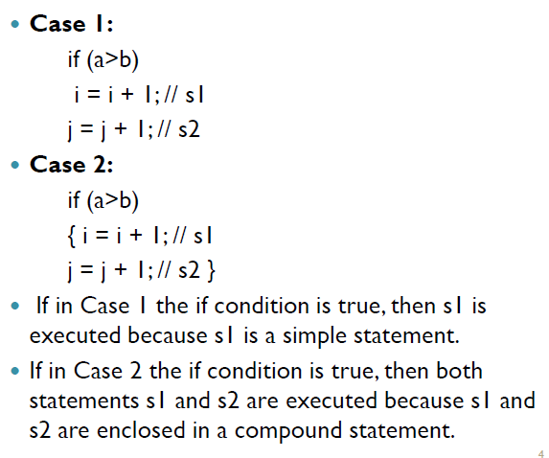

Slide 7
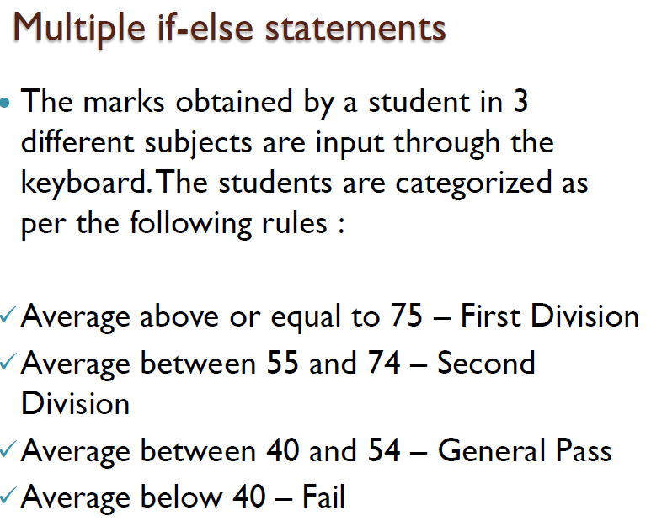

Slide 8
int m1,m2,m3, avg;
m1=45;
m2=36;
M3=89;
avg = (m1+m2+m3)/3;
if (avg>=75)
s.o.p(“First Division Student”);
else
{
if (avg >= 55)
s.o.p(“Second Division Student”);
else
{
if (avg>=40)
s.o.p(“General Pass Student”);
else
s.o.p(“Fail Student”);
}

Slide 9
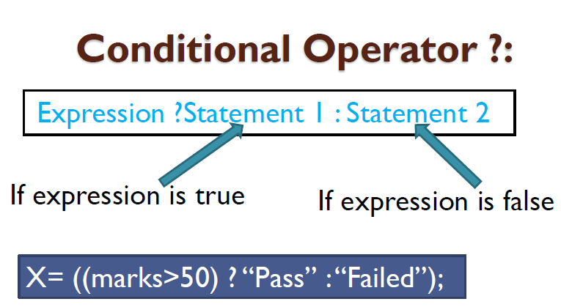

Slide 10
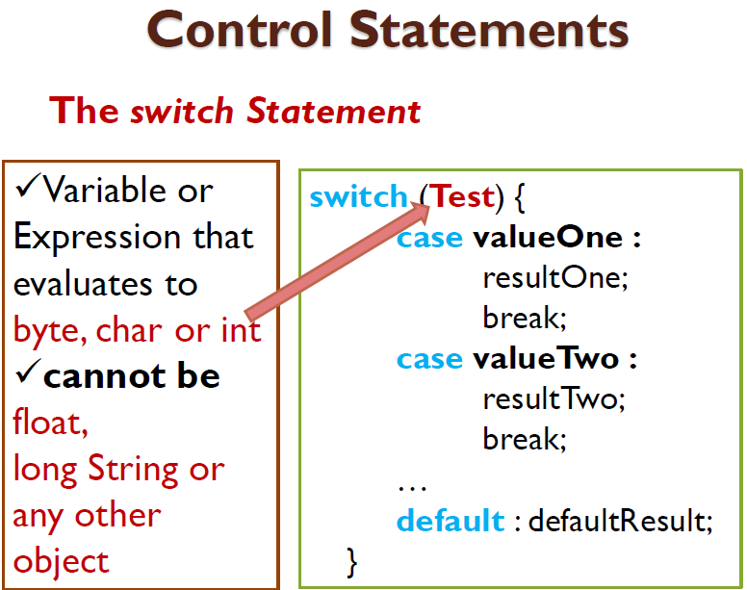

Slide 11
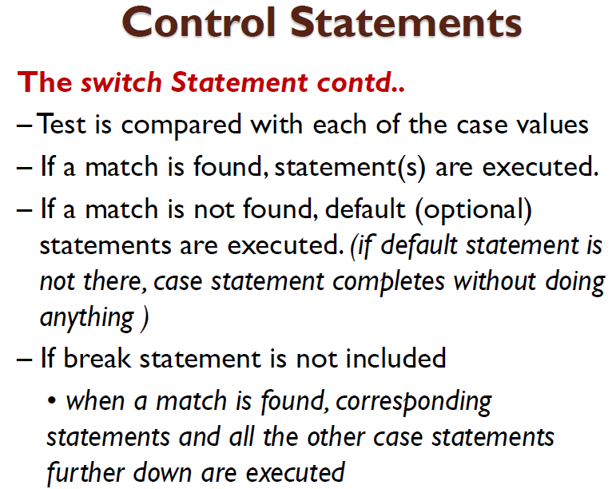

Slide 12
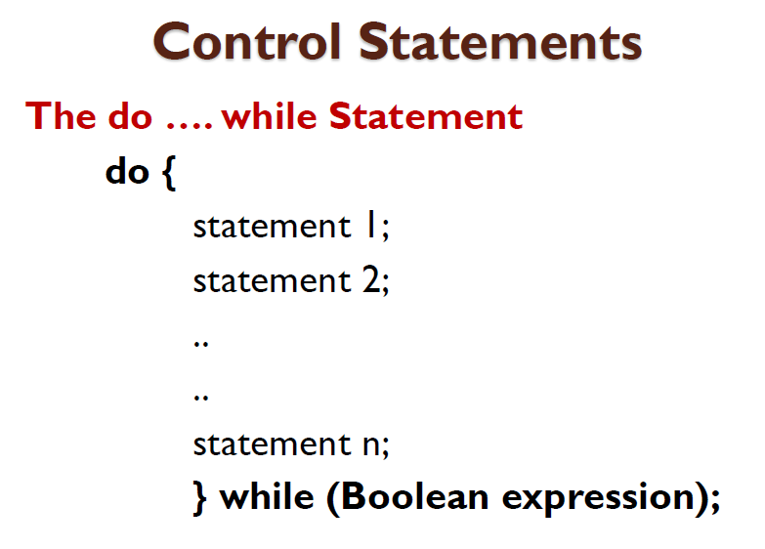

Slide 13
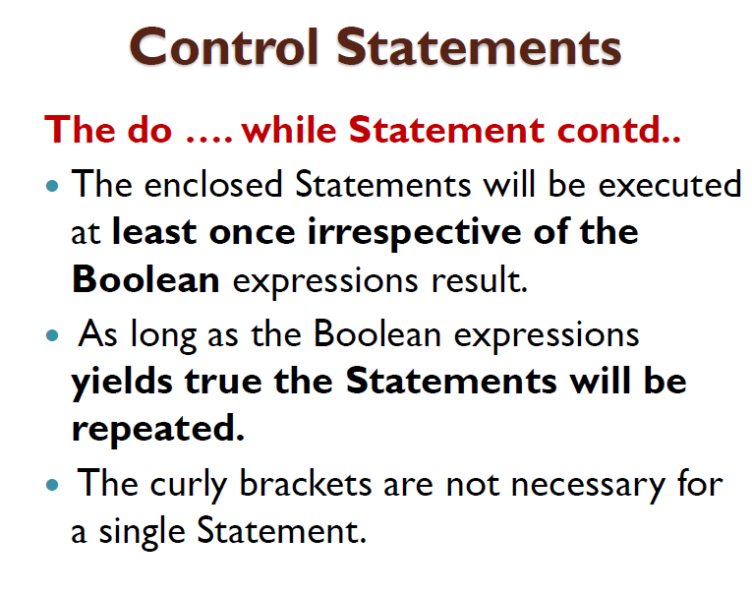

Slide 14
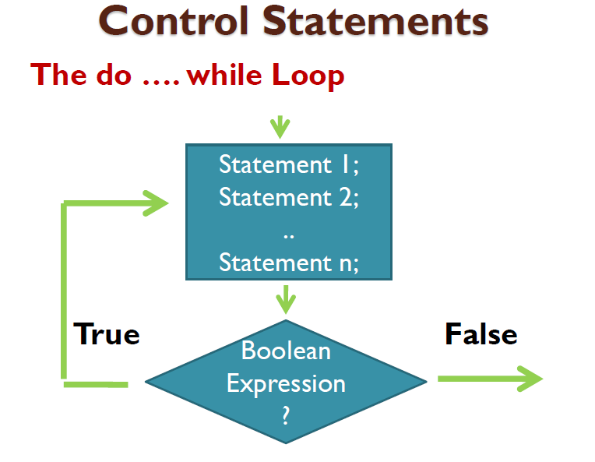

Slide 15
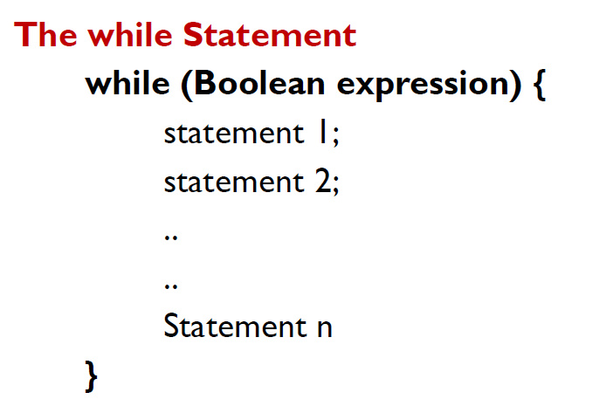

Slide 16
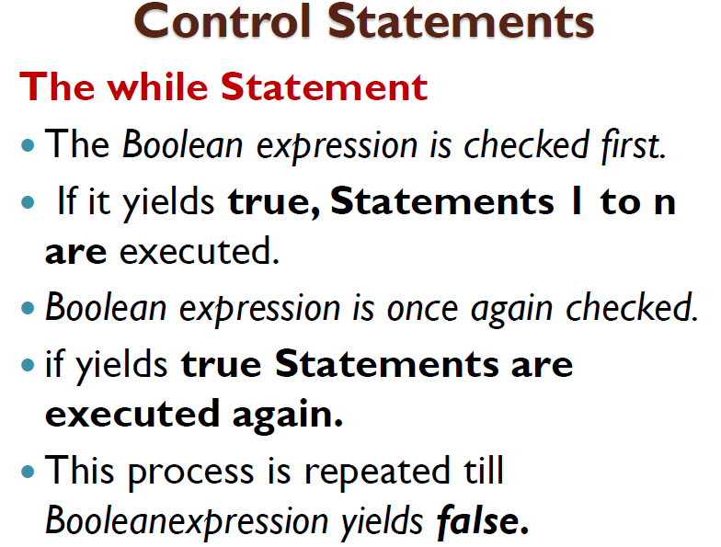

Slide 17
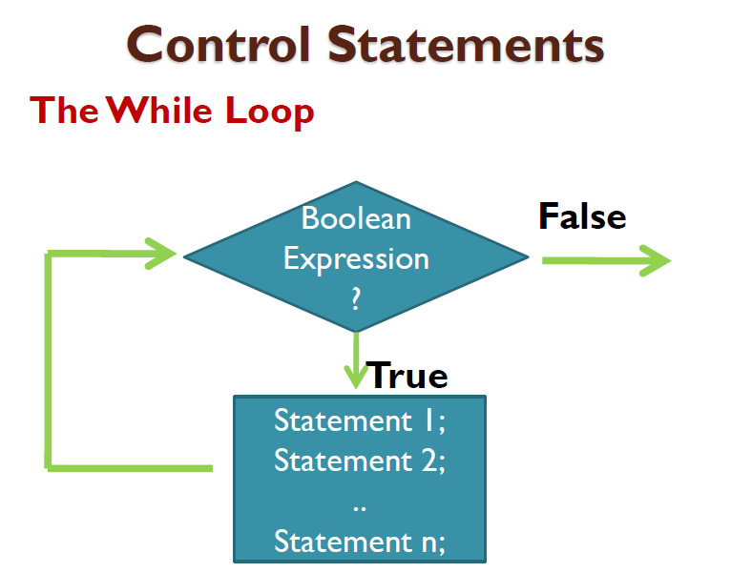

Slide 18
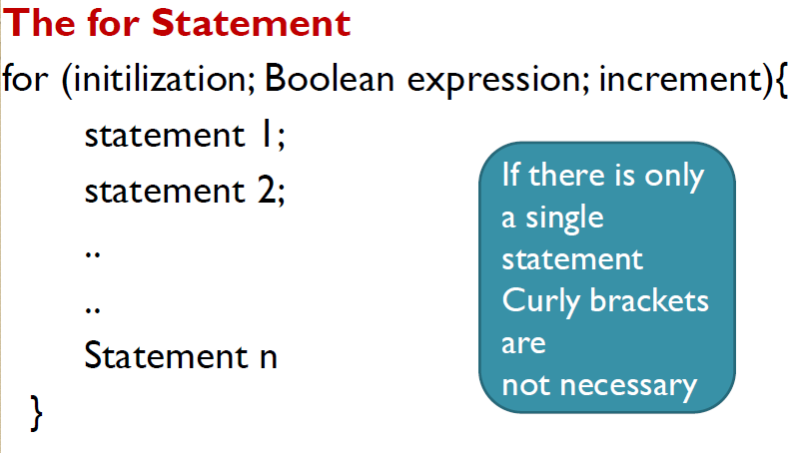

Slide 19
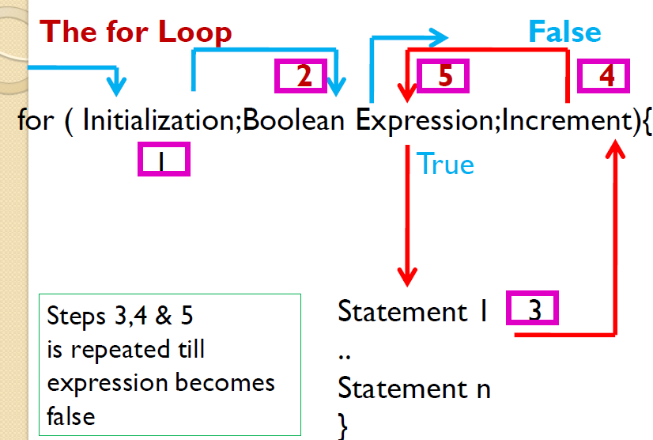

Slide 20
Write a program using while loop to print 1 to 10 numbers?
Write a program using do while loop to print 1 to 10 numbers?
Write a program using for loop to print 1 to 10 numbers

Slide 21
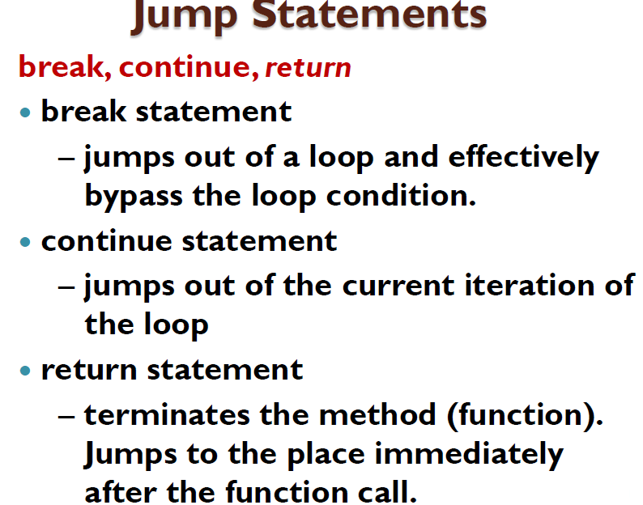

Slide 22
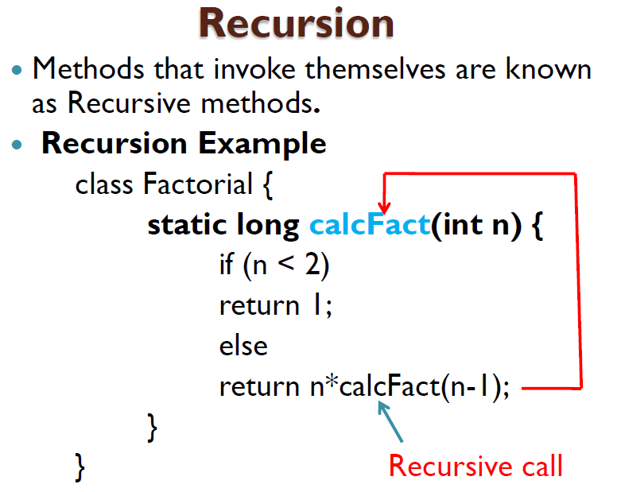
31

Slide 23
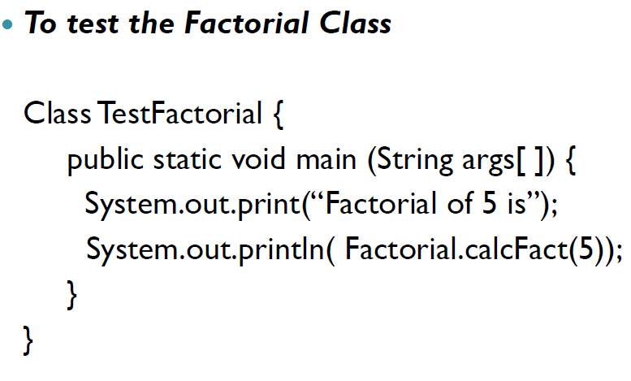

Slide 24

Write a program which will display the followings

